Slide 1
PROJECT THESIS
HumanML3D-Guided Teacher Selection for MoConVQ LoRA Distillation
The new contribution is not just LoRA distillation; it is using HumanML3D motion as a teacher-selection signal.
Original bottleneck
New mechanism
Main finding
HumanML3D provided captions, but its real motions were not used to choose teacher tokens.
Generate multiple teacher candidates and select the one closest to the paired HumanML3D motion.
Candidate diversity is fixed, but alignment gains are small and do not yet improve final student style proxy.
86/200
0.1477
12/22
Non-first top-k teacher candidates selected.
Top-k selected teacher HumanML alignment score.
Final top-k student style-proxy checks improved.
Source: HumanML3D-guided MoConVQ LoRA distillation experiments
1 / 10 - Thesis Report
Notes:
这一页把重点拉回来：这份报告的核心不再是泛泛介绍 LoRA，而是说明我们如何让 HumanML3D 的真实 motion 参与 teacher selection。原始方法主要使用 caption，student 模仿 teacher token；新方法是在同一个 caption 下生成多个 teacher candidate，再用 HumanML3D 对应 motion 的统计特征选择更接近的 candidate。关键结论是：多候选机制已经生效，但 teacher 与 HumanML 的对齐提升还比较小，并没有直接带来最终 student style proxy 的提升。

Slide 2
MOTIVATION
The real gap: HumanML3D motion was available but underused
The project started from a format mismatch, but the deeper issue is supervision quality.
HumanML3D
MoConVQ GPT
Pseudo-token distillation
Problem
caption + continuous 263-D motion features
expects discrete token targets, not HumanML continuous features
teacher samples tokens from caption; student learns CE loss
motion ground truth does not steer which teacher sample is learned
Caption-only distillation can teach a plausible teacher sample even when it is not close to the paired HumanML3D motion.
The new question: can HumanML3D motion help choose a better teacher target before LoRA training?
This reframes the project from “style steering only” to “motion-aware teacher target selection.”
Source: HumanML3D-guided MoConVQ LoRA distillation experiments
2 / 10 - Thesis Report
Notes:
这一页解释为什么要重新组织 PPT。最早的问题看起来是格式不匹配：HumanML3D 是连续动作，MoConVQ GPT 需要离散 token。但更深层的问题是监督质量：如果 teacher 只根据 caption 生成一个样本，student 学到的就是这个样本，而这个样本未必接近 HumanML3D 的真实动作。因此新方法的动机是：让 HumanML3D 的真实 motion 不只是提供 caption，而是参与选择 teacher target。

Slide 3
BASELINE METHOD
Original LoRA distillation learns the teacher, not the dataset motion
Student training loss is token-level cross entropy against selected teacher pseudo-tokens.
Caption
Frozen teacher
Student LoRA
BVH output
“walk slowly”
pretrained MoConVQ GPT samples pseudo-tokens
learns selected token ids with CE / NLL
decoded after training
Important limitation
Implication
The training loss does not directly optimize HumanML distance, naturalness, or style-proxy score. It only asks the student to mimic the selected teacher token.
Better teacher selection is the real control point before LoRA training.
Source: HumanML3D-guided MoConVQ LoRA distillation experiments
3 / 10 - Thesis Report
Notes:
这一页讲清楚 baseline 的含义。训练 LoRA 的 loss 是 cross entropy，也可以理解为 token-level negative log likelihood。它优化的是 student 对 teacher token 的预测概率，不直接优化 HumanML motion distance，也不直接优化人类观感。因此如果 teacher target 选得不好，student 会很认真地模仿一个不一定好的目标。这里自然引出后面的方法：真正要改的是 teacher candidate selection。

Slide 4
PROPOSED METHOD
Motion-aware teacher selection before LoRA training
For each HumanML3D row, generate several teacher candidates and select the one whose BVH metrics best match the paired HumanML3D motion.
HumanML row
Teacher top-k
Candidate BVHs
Selection score
LoRA target
caption + motion_id + true motion metrics
sample 4 stochastic candidates
decode each candidate for measurement
mean log-ratio distance to HumanML metrics
distill selected token ids
Uses HumanML3D motion
Still keeps MoConVQ tokens
Selection is not final training
The paired motion is no longer ignored; it becomes the reference profile for teacher selection.
Student training remains compatible with the pretrained MoConVQ GPT token interface.
The score ranks candidates only; LoRA still trains with CE on the selected tokens.
Source: HumanML3D-guided MoConVQ LoRA distillation experiments
4 / 10 - Thesis Report
Notes:
这一页是新方法的核心流程。对于每一条 HumanML3D 样本，我们有 caption、motion_id 和对应真实 motion。teacher 不再只采样一次，而是用 top-k 随机采样生成多个候选。每个候选被解码成 BVH，计算运动统计，然后和该 motion_id 对应的 HumanML3D 运动统计比较，选出距离最小的 candidate。最后 student 仍然用 cross entropy 学这个被选中的 token。这样既利用了 HumanML3D motion，又保持 MoConVQ token 训练路径不变。

Slide 5
SELECTION SCORE
The candidate score measures closeness, not lower-is-better style
score = mean | log(candidate_metric / HumanML_metric) | → lower is closer
This is different from the old style proxy. If the HumanML speed is not zero, collapsing speed to zero is penalized, not rewarded.
duration_sec
root_speed_mean
root_path_length
mean_joint_velocity
mean_joint_acceleration
mean_joint_jerk
root_vertical_range
all_joint_vertical_range
Good for
Weak for
global speed, duration, vertical motion, and whole-body intensity.
fine hand actions, object-like semantics, complex dance identities, and local motion order.
Source: HumanML3D-guided MoConVQ LoRA distillation experiments
5 / 10 - Thesis Report
Notes:
这一页重点澄清 scoring。新 selection score 不是 lower-is-better 风格得分，而是接近度得分。公式是 candidate metric 和 HumanML metric 的 log ratio distance 取平均，越小表示越接近。比如 HumanML 的速度是 0.5，candidate 速度变成 0 并不会得高分，反而会因为和目标差得远而被惩罚。这套指标适合捕捉速度、时长、整体幅度、竖直起伏等全局运动特征，但不擅长捕捉手部动作、复杂舞蹈语义或动作顺序。

Slide 6
KEY FIX
Top-k sampling makes multi-candidate selection real
Before stochastic top-k sampling, multiple candidates were nearly identical. After the fix, non-first candidates were selected 86 times.
Deterministic teacher.sample
Top-k stochastic teacher.sample
candidate 0: 199
candidate 0: 114
candidate 1: 1
candidate 1: 31
candidate 2: 32
candidate 3: 23
Before
After
Multiple-sample filtering almost did not matter because the teacher output was effectively deterministic.
Top-k and temperature expose meaningful variation, so HumanML selection can actually choose among candidates.
Source: HumanML3D-guided MoConVQ LoRA distillation experiments
6 / 10 - Thesis Report
Notes:
这一页展示第一个明确成果：原先虽然代码上生成多个 candidate，但 teacher.sample 在 if_categorial=False 时几乎确定性，200 个样本里 199 次都选第一个。这说明多候选筛选基本没有发挥作用。加入 top-k stochastic sampling 后，选择分布变成 0 号 114 次，1 号 31 次，2 号 32 次，3 号 23 次，非第一个 candidate 合计 86 次。也就是说，selection 机制终于有了真实选择空间。

Slide 7
EVALUATION RESET
The old style proxy and HumanML alignment answer different questions
Direction
Closeness
Old style proxy
New HumanML alignment
Compares LoRA BVH against baseline BVH. It asks whether motion metrics moved in a hand-written style direction, such as slower speed for “slow deliberate”.
Compares generated or selected BVH against the paired HumanML3D motion. It asks whether the motion statistics are close to the dataset reference.
Why this matters
A lower-is-better proxy can reward over-shooting, such as making speed too low.
HumanML alignment penalizes both too high and too low values if they move away from the paired motion.
Source: HumanML3D-guided MoConVQ LoRA distillation experiments
7 / 10 - Thesis Report
Notes:
这一页解释为什么旧结果和新结果不能混在一起解读。旧 style proxy 比较的是 LoRA 和 baseline，看 LoRA 是否朝我们手写的风格方向变化；它不是在比较是否接近 HumanML3D。新 HumanML alignment 比较的是 candidate 或生成动作和对应 HumanML3D motion 的接近程度。两个指标回答的问题不同：旧指标问风格方向有没有更明显，新指标问是否更接近真实数据。

Slide 8
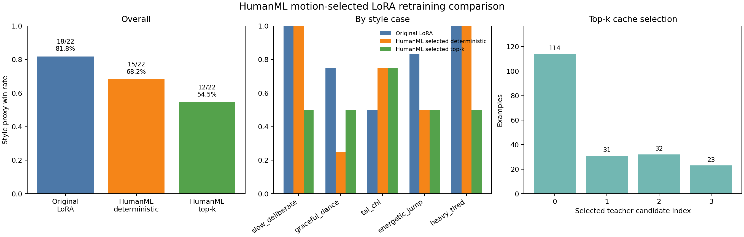
RESULTS
Top-k improves teacher alignment slightly, but not final student proxy
Original LoRA style proxy
HumanML deterministic
HumanML top-k
18/22
15/22
12/22
12/22
0.1477
small gain
Style proxy dropped
Teacher alignment improved
Interpretation
Old directional score: original 18/22, deterministic 15/22, top-k 12/22. This says the final student did not improve under the old proxy.
Selected teacher distance moved from 1.9666 to 1.9419, and score from 0.1443 to 0.1477.
The teacher-selection target changed, but the final student generation objective did not yet fully inherit that improvement.
What the two metrics say
Run
Old style proxy
HumanML alignment
Interpretation
Original LoRA
18/22
not measured here
strong old proxy
HumanML deterministic
15/22
score 0.1443
teacher baseline
HumanML top-k
12/22
score 0.1477
slightly closer teacher
Reading: top-k fixes the teacher-selection mechanism, but the final student result still needs paired HumanML generation evaluation.
Source: HumanML3D-guided MoConVQ LoRA distillation experiments
8 / 10 - Thesis Report
Notes:
这一页把结果讲清楚：如果用旧 style proxy，top-k 结果反而更低，只有 12/22；但如果看新 HumanML alignment，top-k selected teacher 比 deterministic selected teacher 略好，distance 从 1.9666 降到 1.9419，score 从 0.1443 升到 0.1477。这个结果不是简单失败，而是说明两个目标不同：我们确实改善了 teacher selection 的候选多样性和一点点 HumanML 对齐，但还没有证明最终 student 的生成结果也更接近 HumanML。

Slide 9
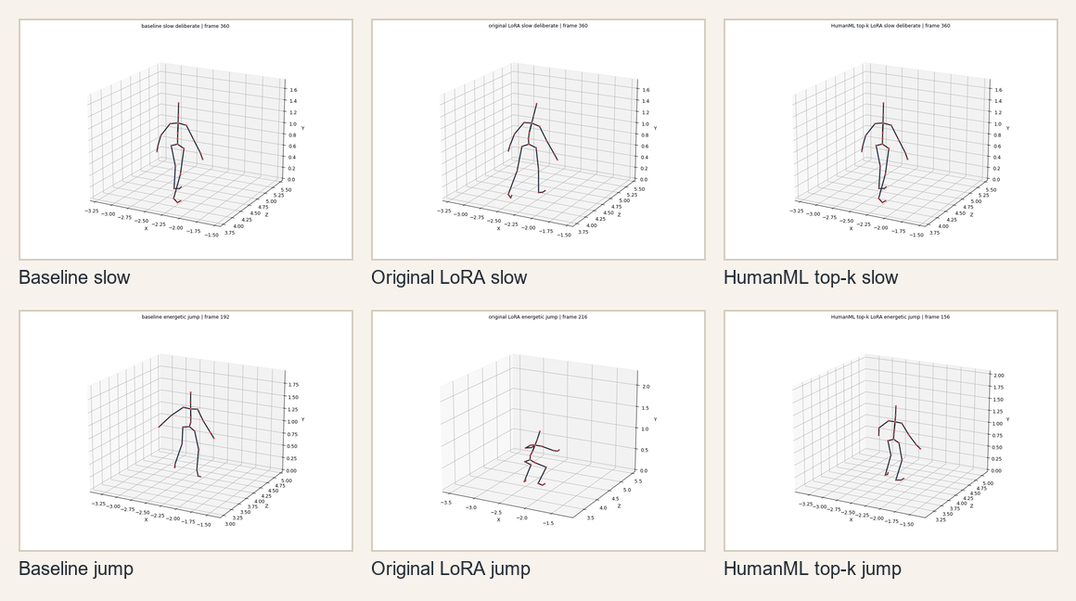
WHERE IT WORKS
Alignment is better for global whole-body motions than local semantics
Samples that align better
Running, sprinting, jumping, forward motion
Clear root speed, path length, and vertical range
Caption describes global body dynamics
Samples that align worse
Hand waving, lifting, object-like actions
Complex dances such as chicken dance
On-the-spot or local motion sequences
Source: HumanML3D-guided MoConVQ LoRA distillation experiments
9 / 10 - Thesis Report
Notes:
这一页解释哪些样本对得上，哪些对不上。新 alignment 不是说只有部分数据有 ground truth，而是 200 条都能按 motion_id 对齐；差别在于运动统计是否真的接近。跑步、跳跃、前进这类全身运动比较容易对上，因为 root speed、path length、vertical range 能捕捉它们。挥手、拿东西、复杂舞蹈、局部动作顺序则对得差，因为当前指标主要是全局运动统计，无法充分表达局部语义。

Slide 10
CONCLUSION
The contribution is a better bridge, not a finished evaluator
HumanML3D motion can guide teacher selection, but the final student still needs paired HumanML generation evaluation.
HumanML3D motion can guide teacher selection; the final student still needs paired HumanML generation evaluation.
1
2
3
What is solved
What is not solved
Next step
HumanML3D motion is now used as a reference during teacher candidate selection; top-k sampling creates real candidate diversity.
Selected teacher alignment gains are small, and the final student has not been evaluated against paired HumanML motions yet.
Generate baseline and LoRA BVHs from HumanML3D captions, then compare each output to the corresponding motion_id.
Takeaway
The method moves the project from caption-only pseudo-token distillation toward data-grounded teacher selection. The next experiment should close the loop at the student-output level.
Source: HumanML3D-guided MoConVQ LoRA distillation experiments
10 / 10 - Thesis Report
Notes:
最后总结。现在最重要的贡献不是最终分数已经全面提升，而是建立了一个更合理的桥：HumanML3D motion 可以参与 teacher selection，top-k 机制也让这个选择真正生效。还没有解决的是最终 student 是否更接近 HumanML3D，因为目前新 alignment 主要评估 selected teacher candidate。下一步应该用 HumanML3D caption 重新生成 baseline 和 LoRA BVH，再和每个 motion_id 的真实 motion 对齐，这样才能完整评估学生模型是否真正受益。

